Slide 1
Module - IV: Advanced Prompt Techniques: Multi-turn conversations. Prompt chaining and pipelines. Dynamic prompt templates.

Slide 2
Advanced Prompt Techniques
Advanced Prompt Techniques are methods used to design prompts that maximize the quality, accuracy, and usefulness of AI outputs.
Unlike basic prompts (simple questions or commands), advanced techniques control context, reasoning, style, constraints, and multi-step processing.

Slide 3
Need of Advanced Prompts
Handle Complex Tasks – Multi-step reasoning, coding, content generation, research.
Improve Accuracy – Reduce errors, hallucinations, or vague responses.
Control Output – Specify tone, style, format, or length.
Enable Creativity – Brainstorming, role-playing, or idea exploration.
Iterative Refinement – Allows step-by-step improvement of answers.
Domain-Specific Applications – Legal, medical, coding, or business prompts.

Slide 4
Multi-turn conversations
Multi-Turn Conversation Prompt Engineering is the process of designing and structuring prompts for AI to handle iterative, context-aware dialogues.
Multi-Turn Conversations are interactions where the AI and user engage in a back-and-forth dialogue, with each response building on previous turns.

Slide 5
Objectives of Multi-Turn Conversations
Maintain Context Across Turns
Ensure the AI remembers previous messages or instructions to provide coherent and relevant responses.
Example: In a coding discussion, AI remembers the function or variable names from earlier turns.
Iterative Refinement of Output
Gradually improve responses by following up on previous outputs.
Example: Summarize an article → review for missing points → rewrite concisely.
Clarification and Disambiguation
Resolve misunderstandings or ambiguous instructions.
Example: “Explain abstraction in Python.” → “Clarify the difference between abstract class and interface.”
Error Detection and Correction
Identify mistakes in previous responses and provide corrected outputs.
Example: AI checks a generated SQL query for syntax errors or logical issues.
Role & Perspective Control
Switch AI’s role, tone, or persona during the conversation for task-specific guidance.
Example: “Act as a teacher → Now act as an examiner → Evaluate my answer.”
Support Complex Task Handling
Break down large tasks into smaller steps handled over multiple turns.
Example: Designing a web app step by step: database → backend → frontend.
Encourage Critical Thinking and Reflection
AI reviews its own output to improve quality and reasoning.
Example: “Check your previous summary for missing key points and rewrite if needed.”
Enable Creativity and Brainstorming
Explore multiple ideas or approaches progressively.
Example: Generate 5 marketing strategies → refine for social media → select best 3.
Improve User Control and Interaction
Give users the ability to guide AI responses based on feedback, preferences, or constraints.
Example: “Use simpler language” or “Focus on technical accuracy.”

Slide 6
A typical multi-turn conversation has the following flow:
Initial Prompt / Task – Define the main task.
Example: “Explain polymorphism in Python.”
Clarification / Follow-up – Ask AI to expand, simplify, or clarify.
Example: “Can you give a real-world example?”
Stepwise / Detailed Explanation – Break down complex tasks.
Example: “Show a Python code snippet and explain each line.”
Role / Persona Prompt (Optional) – Assign AI a perspective.
Example: “Explain this as if teaching a beginner.”
Reflection / Verification – AI reviews and improves its output.
Example: “Check if the code covers all cases and rewrite if needed.”
Constraints / Optimization (Optional) – Specify rules or limits.
Example: “Keep the explanation under 100 words and concise.”
Final Output / Summary – Polished and complete version.
Example: “Summarize the function’s purpose and key logic in 2 sentences.”

Slide 7
Importance of Multi-Turn Prompts
Enable context retention at each turn.
Ensure seamless and natural flow in AI conversations.
Useful for complex scenarios with multiple questions and responses.
Transform AI chatbots into interactive companions (e.g., healthcare, customer support).

Slide 8
Essential Elements in Multi-Turn Prompt Design
Context Preservation
Retain relevant information from previous interactions.
Helps AI understand user intent and provide accurate responses.
Coherence & Smooth Flow
Ensure logical progression in conversation.
Avoid contradictions or confusing transitions.
Clear Instructions
Define desired tone, style, or response format.
Essential for all prompt engineering techniques.
Optimal Prompt Length
Include only relevant information from prior conversation.
Avoid excessively long prompts that may confuse AI.

Slide 9
Value of Multi-Turn Prompting
Create more natural and engaging chatbots.
Enable AI to handle complex conversations across multiple topics.
Example: Healthcare chatbots understanding patient concerns through dialogue.
Flexible for multifaceted scenarios with different nuances.

Slide 10
Challenges in Multi-Turn Prompt Engineering
Maintaining Consistency & Coherence
Ensuring consistent style and tone.
Avoiding contradictions in responses.
Preserving Context
Adding information from previous turns accurately.
AI may give irrelevant responses without proper context.
Ambiguous Prompts
Users may provide incomplete or unclear information.
AI might interpret prompts in multiple ways.
Capturing Conversational Dynamics
Understand human nuances: emotions, implied meaning, sarcasm.
Adapt to changes in user intent or topic.

Slide 11
Solutions and Best Practices
Clear Context Cues
Provide summaries or key points from previous turns.
Use memory mechanisms to retain relevant context.
Use Conversation History
Allow AI to access entire dialogue history.
Ensures responses are contextually accurate and relevant.
Leverage Feedback Loops
Incorporate user feedback to refine prompts continuously.
Helps AI produce coherent and relevant outputs.
Prompt Chaining
Break large conversations into smaller prompts.
Use outputs from one prompt as input for the next.
Helps in context preservation and task decomposition.
Be Specific and Structured
Provide clear instructions for tone, detail, and format.
Use keywords or role assignments to reduce ambiguity.

Slide 12
Example 1: Education / Tutoring (Multi-Turn)
Turn 1 (User Prompt):
You are a Python tutor. Explain loops in simple terms.
Turn 2 (User Prompt):
Give an example using for loop.
Turn 3 (User Prompt):
Now explain the same using a real-life analogy.
Example 2: Technical Support Chatbot
Turn 1:
My laptop is overheating.
Turn 2:
It happens mainly while coding.
Turn 3:
I use Python and VS Code. What should I do?

Slide 13
Simple Multi-Turn Prompt Template
Turn 1: Introduce topic
Turn 2: Ask for explanation or example
Turn 3: Ask for deeper analysis or reflection
Turn 4: Ask for improvement or application

Slide 14
Prompt Chaining
Prompt Chaining is a prompt engineering technique where the output of one prompt is used as input for the next prompt, creating a sequence of connected prompts to solve complex tasks.
Purpose:
Handle multi-step reasoning tasks.
Break complex problems into smaller, manageable prompts.
Preserve context across multiple prompts.

Slide 15
Structure
Initial Prompt: Provide the first instruction/task.
Intermediate Output: AI generates a response.
Next Prompt: Feed AI’s previous output as input, adding further instructions.
Repeat: Continue chaining until the final output is complete.

Slide 16
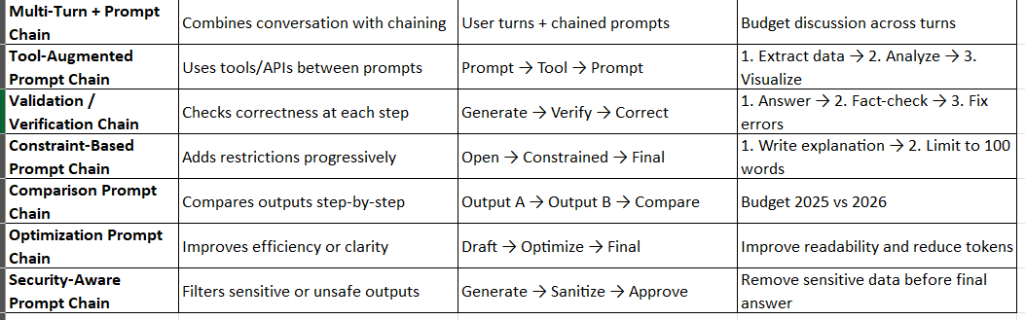
Types of Prompt Chains

Slide 17
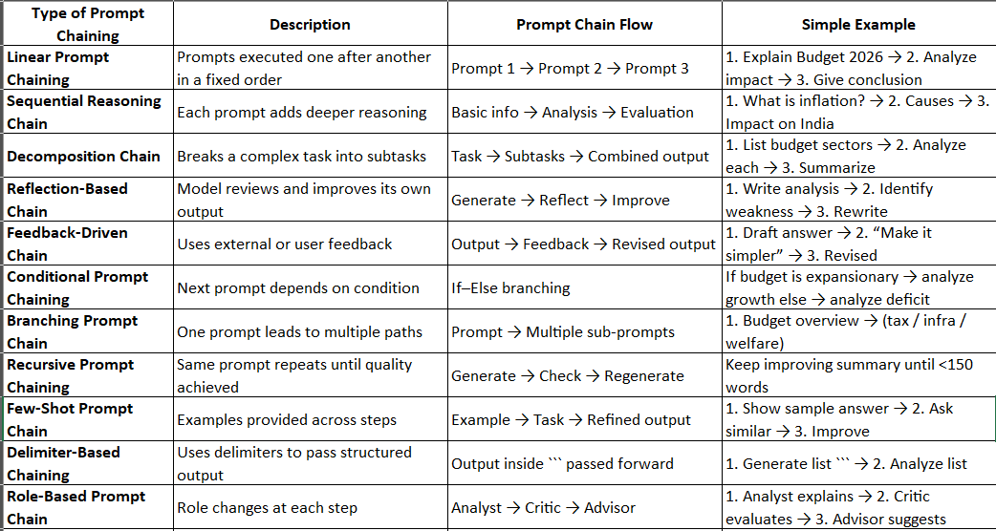

Slide 18
Prompt Engineering : In prompt engineering, prompt chaining is a method of connecting multiple prompts to handle complex tasks, maintain context, or iteratively refine outputs. Broadly, the types of prompt chaining can be categorized as follows:

Slide 19
Sequential Chaining
Definition: Prompts are executed one after another, where the output of one prompt becomes the input for the next.
Purpose: Break complex tasks into smaller steps.
Example:
Summarize a long article.
Extract key points from the summary.
Create action items from key points.

Slide 20
Conditional / Branching Chaining
Definition:
The next prompt depends on the response of the previous one, allowing for different “branches” of execution.
Purpose: Handle decision-based workflows or dynamic user paths.
Example:
Ask the user if they want a “tutorial” or a “product recommendation.”
Route to the appropriate follow-up prompt based on the choice.

Slide 21
Iterative / Looping Chaining
Definition: The same prompt (or a set of prompts) is applied repeatedly, with each iteration improving or refining the output.
Purpose: Refine answers, summaries, or creative content.
Example:
Prompt: “Improve this paragraph for clarity.”
Feed the improved paragraph back into the same prompt for further refinement.

Slide 22
Parallel Chaining
Definition: Multiple prompts are executed simultaneously on the same input, generating different perspectives, which are later combined.
Purpose: Obtain multi-faceted analysis or diverse outputs.
Example:
Analyze tone, grammar, and key points of a text in parallel.
Combine results into a single report.

Slide 23
Feedback / Self-Improvement Chaining
Definition: The AI evaluates its own output and generates new prompts to improve or correct it.
Purpose: Self-correction, fact-checking, or iterative quality enhancement.
Example:
Generate a product description.
Review the description for errors and clarity.
Rewrite the description based on the review.

Slide 24
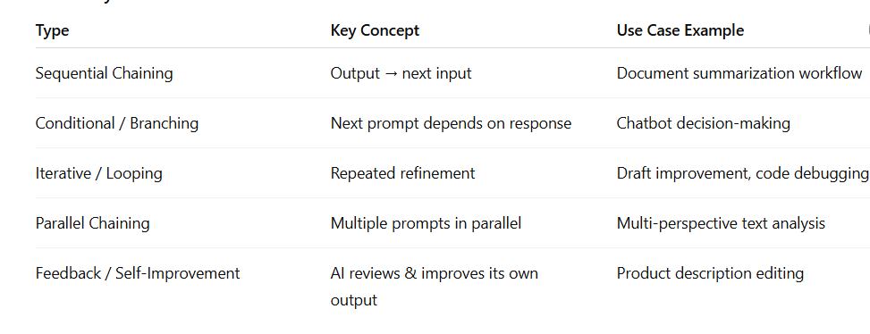

Slide 25
Prompt Engineering
In prompt engineering, a pipeline refers to a structured sequence of steps or prompts that are designed to work together to achieve a complex task.
Instead of giving a single prompt to an AI model, a pipeline breaks down the task into smaller subtasks, processes the outputs of each step, and passes them along to the next stage.
Think of it like a factory assembly line for text or data: each stage performs a specific function, and the final product is the desired output.
Key idea: Pipelines allow multi-step reasoning, refinement, and task decomposition, which is essential for complex AI interactions.

Slide 26
Prompt Engineering Pipelines
Modularity
Each stage of the pipeline can be independently designed and modified.
Example: One stage extracts keywords, another generates a summary, another checks grammar.
Sequential Processing
Output from one prompt feeds into the next prompt.
Example: Question → Answer → Explanation → Translation.
Task Decomposition
Complex problems are broken into simpler subtasks.
Example: Writing a research report can be split into “outline generation,” “draft writing,” and “proofreading.”
Refinement and Iteration
Outputs can be refined or improved over multiple stages.
Example: Initial draft → style improvement → fact-checking.
Integration with External Tools
Pipelines can incorporate APIs, databases, or other models for enhanced outputs.
Example: AI generates content → spell-check API → plagiarism checker.
Reusability
Individual stages can be reused for different workflows.
Example: A “text summarizer” stage can be used for news, research papers, or emails.

Slide 27
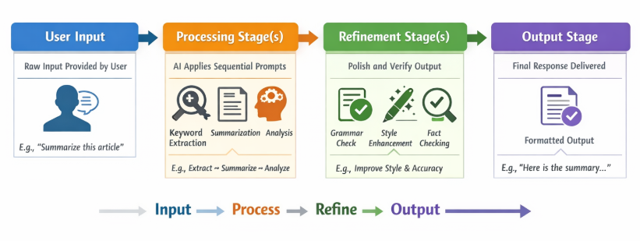
Working of the Prompt Engineering Pipelines

Slide 28
Example 1: Research Paper Summary Pipeline
Input: Long academic paper
Stage 1: Extract key sections (abstract, conclusion)
Stage 2: Generate summary
Stage 3: Simplify language for general audience
Stage 4: Check grammar and style
Output: Readable summary of research paper

Slide 29
Example 2: Customer Support Automation
Input: Customer complaint email
Stage 1: Classify type of issue (billing, technical, etc.)
Stage 2: Generate draft response
Stage 3: Check tone and politeness
Stage 4: Send response to customer
Output: Automated, professional reply

Slide 30
Example 3: Content Creation Pipeline
Input: Topic prompt (“Healthy breakfast recipes”)
Stage 1: Generate outline
Stage 2: Create detailed content for each section
Stage 3: Optimize for SEO
Stage 4: Proofread and improve readability
Output: Blog post ready for publishing

Slide 31
Applications
Content Generation
Articles, blogs, social media posts
Marketing copy with multi-step refinement
Customer Support
Automated email responses
Chatbots with multi-turn interactions
Data Analysis
Extract insights from reports or datasets
Summarize key metrics and trends
Education & Tutoring
Step-by-step problem solving
Personalized study material generation
Healthcare
Summarizing patient records
Generating treatment suggestions based on multiple sources
Legal and Compliance
Drafting contracts
Summarizing regulations or legal documents

Slide 32
Dynamic prompt templates
A Dynamic Prompt is a type of AI prompt that changes or adapts automatically based on input, context, or variables. Instead of being static, it uses placeholders or rules to generate content tailored to specific situations.
Key idea: Dynamic prompts make AI responses more flexible, personalized, and context-aware.

Slide 33
Features of Dynamic Prompts
Context-aware: Changes based on the input data or situation.
Reusable templates: Same structure can generate multiple outputs.
Variable-driven: Uses placeholders (like {name}, {topic}) that get replaced dynamically.
Adaptive responses: Can adjust tone, style, or detail level automatically.
Automation-friendly: Works well in pipelines and multi-turn interactions.

Slide 34
Dynamic Prompt Template
A dynamic prompt template is a prompt that changes automatically based on:
user input
context
variables
system state
previous conversation turns
Instead of hard-coding the prompt, we use placeholders like {topic}, {level}, {role}, {constraints}.

Slide 35
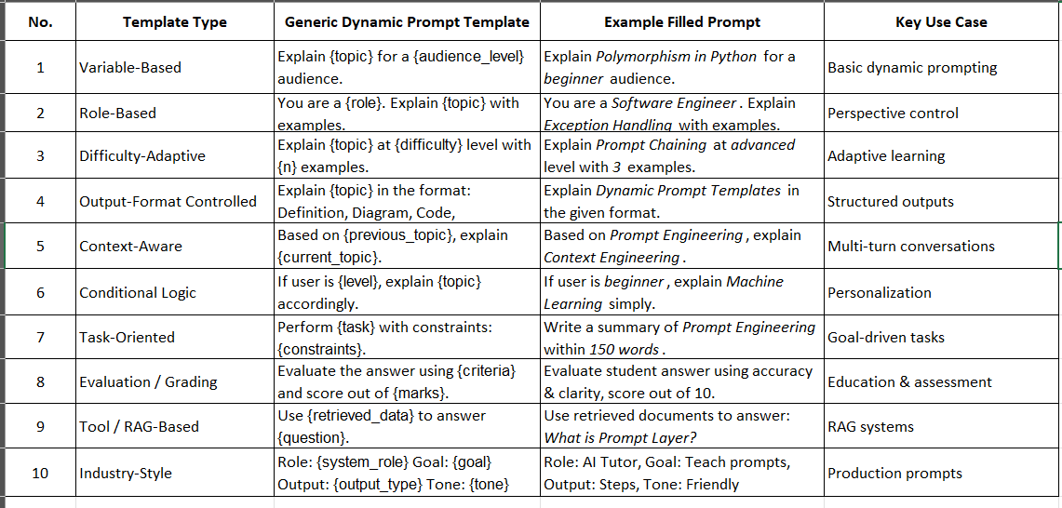

Slide 36
